Slide 1
Full Stack Application Development
Web Protocols
Communication with Backend
Web Hooks
Akshaya Ganesan

Slide 2
Webhooks

Slide 3
Webhooks
A webhook is an HTTP-based callback function that allows lightweight, event-driven communication between 2 application programming interfaces (APIs).
This callback is an HTTP POST that sends a message to a URL when an event happens.
To set up a webhook, the client gives a unique URL to the server API and specifies which event it wants to know about.

Slide 4
Webhooks
Once the webhook is set up, the client no longer needs to poll the server;
When the specified event occurs, the server will automatically send the relevant payload to the client’s webhook URL.
Webhooks are often called reverse APIs or push APIs because they put communication responsibility on the server rather than the client.

Slide 5
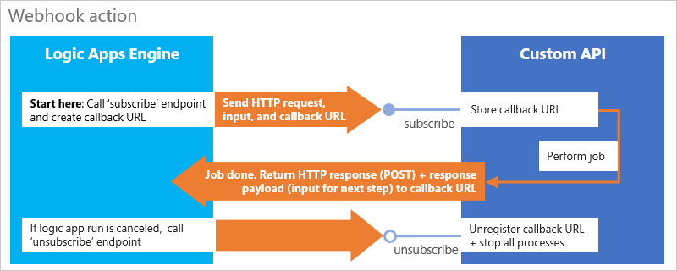
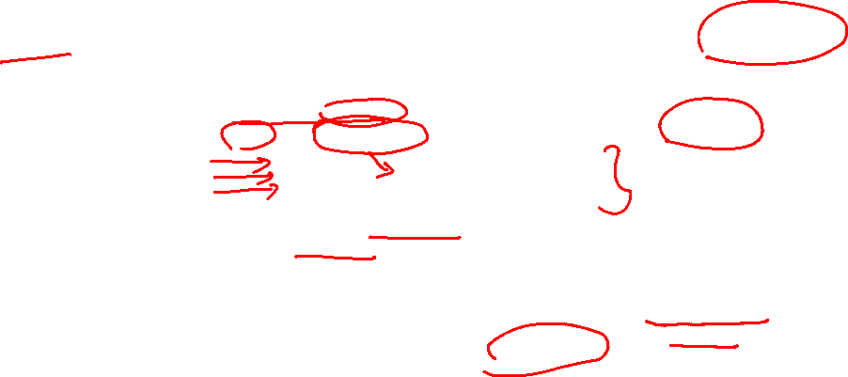
Webhooks

Slide 6
Webhooks
Client-side application is the one making the request to the API on the server-side.
The client-side must be running a server, and the “server-side” must be running a server.
The client-side application makes an API request to the server-side server, and sends the server-side server a webhook to call once the server-side wants to notify the client-side” application of some event

Slide 7
Webhooks
Once the event occurs, and the server-side application calls the webhook url, the server that is running on the client-side application will receive that “webhook” notification.
Front end applications eg. pure React JS, AngularJS, Mobile Apps, cannot use webhooks directly.
Webhooks basically are APIs implemented by API consumers but defined and used by API providers to send notifications of events.

Slide 8
Webhooks
Eliminate the need for polling
Are quick to set up.
Automate data transfer.
Are good for lightweight, specific payloads.

Slide 9
Webhooks

Slide 10
Thank You!

